Slide 1
NODE.JS
(The Backend Of MERN Stack)
Lecture 14

Slide 2
Today’s Agenda
What are events ?
Events in Node Js
Need of learning about events
The events module
The EventEmitter class
Registering and firing events
Creating custom events
Removing events
Registering only once

Slide 3
What are events ?
An Event is any activity that takes place while the application is running and it causes the application to do something or take some action.
For example , in browser based JS the user’s action of clicking a button is an event and in respond to that our application then executes some code.

Slide 4
Some real world examples
Let’s assume you’re signing up on a website and you're supposed to receive an OTP after inputting your number.
When you click ‘Send OTP’, an event gets triggered and the website admin is notified of the new signup.
The admin will automatically react to this by sending an OTP to your phone number.

Slide 5
Some real world examples
Another event response is a welcome email when you complete signup.
The admin will receive several other signups/OTP requests.

Slide 6
What are events in node js ?
Similarly whenever something happens in the Node.js world, we call it an event.
For example:
When a user opens a file, we say that an event has occurred.
If a file is read by any function like readFile(), it is said to be another event.

Slide 7
Why we need to learn about events ?
In Node, we have a class called http that we will use to build our own web server.
So we listen on a given port, and every time we receive a request on that port, that http class raises an event.
Now our job will be to respond to that event which basically involves reading that request and returning the right response.

Slide 8
The events module
The events module allows us to easily create and handle custom events in Node.js.
This module includes the EventEmitter class, which is used to raise and handle the events.

Slide 9
The events module
Almost the whole of the Node.js core API is built around this module, which emits named events that cause function (also known as listeners) to be called

Slide 10
The events module
EventEmitter methods | Description
addListener(event, listener) | Adds a listener to the end of the listeners array for the specified event..
on(event, listener) | It can also be called as an alias of addListener()
once(event, listener) | Adds a one-time listener for the event. This listener is invoked only the next time the event is fired, after which it is removed.
emit(event, [arg1], [arg2], [...]) | Raises the specified events with the supplied arguments.
removeListener(event, listener) | Removes a listener from the listener array for the specified event.
removeAllListeners([event]) | Removes all listeners, of the specified event.

Slide 11
Steps needed for event based programming
Step 1: Import the “events” module.
Step 2: Create an instance of “EventEmitter”
Step 3: Using that instance set up an event and its listener function by calling the method on(). The first argument in the on() is the event name and the second is the event handler function of the event.
Step 4: Finally using the same instance of EventEmitter class call the emit() method, which fires the event and causes the handler function to run .

Slide 12
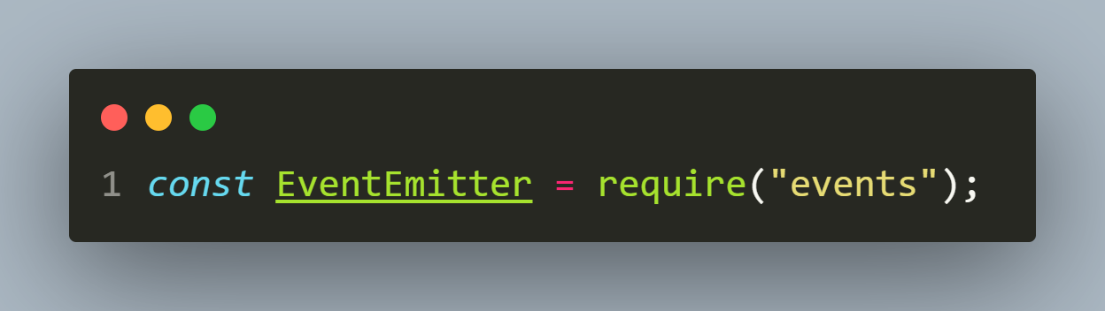
Step 1- importing the module
To begin, we'll need to import the events module.
This module exports a class called EventEmitter .

Slide 13
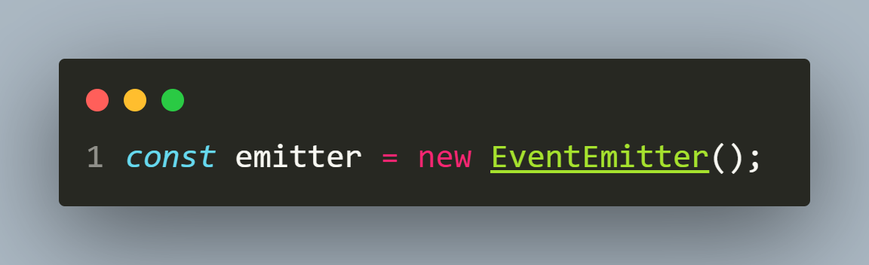
Step 2- instantiate eventemitter
Now that we have access to EventEmitter class we must create its object in order to call its methods on() and emit() .

Slide 14
Step 3- register a listener
Third step is listening/registering for events and we do this by calling the on() method of EventEmitter .
The on() method takes an event name and a callback function as parameters.

Slide 15
Step 3- register a listener
When the event with the event name is passed into the on() method is emitted, it invokes its callback function.
This method returns a reference to the EventEmitter, allowing us to chain multiple calls.

Slide 16
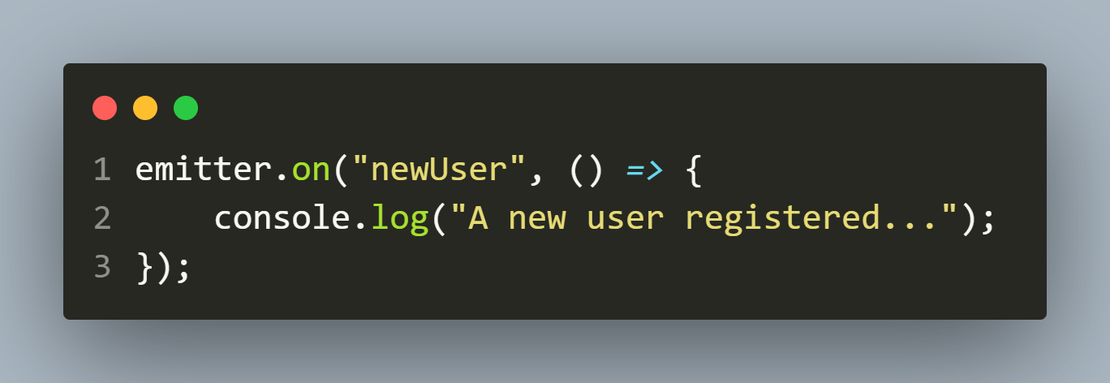
Step 3- register a listener

Slide 17
Step 4- emit the event
We can emit events using the EventEmitter’s emit() method.
The emit() method takes an eventName and an arbitrary number of arguments as parameters.

Slide 18
Step 4- emit the event
Once we call the emit() method, it emits the passed eventName.
Then it synchronously calls each of the event's listeners in the order we registered them, passing the supplied arguments to each.
Finally, it returns true if the event had listeners and false if it didn't have any listeners.

Slide 19
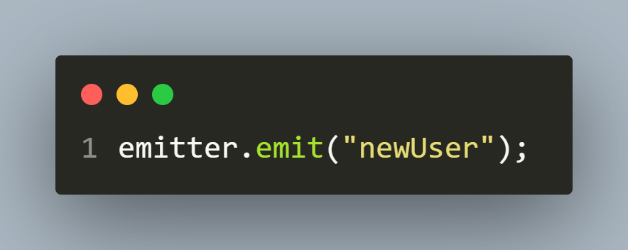
Step 4- emit the event

Slide 20
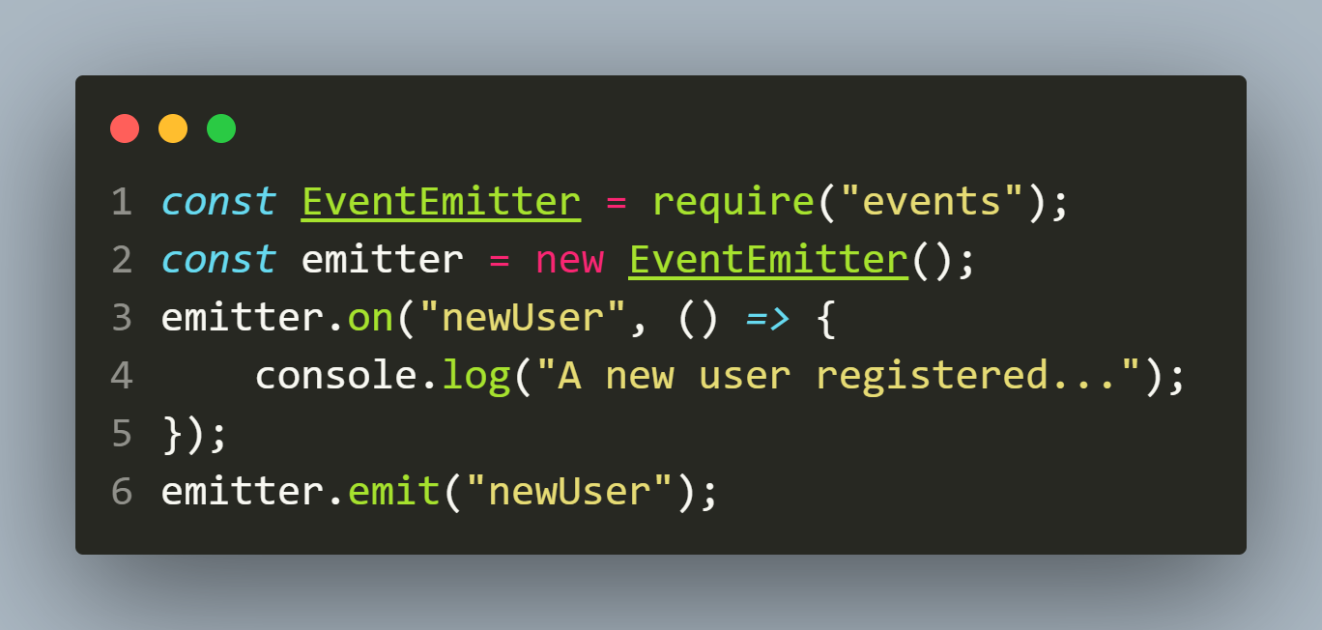
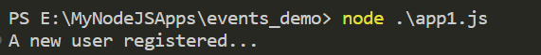
Complete code
app1.js
output

Slide 21
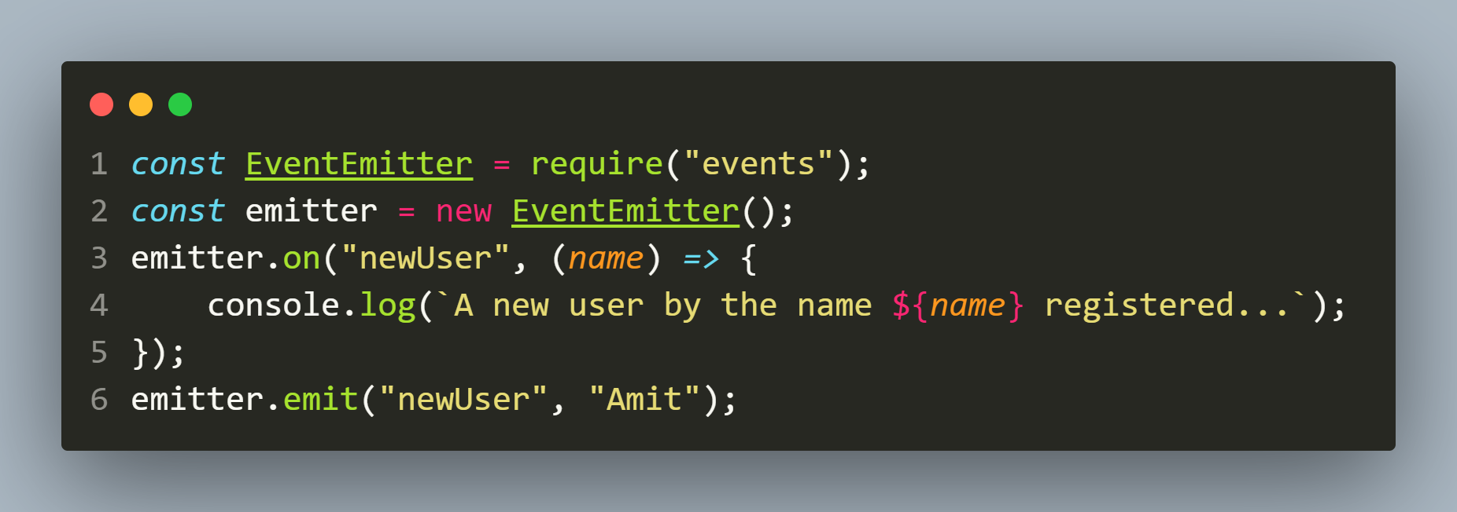
Passing arguments
When emitting an event, we can also pass arguments into it.
For example we can pass the name of new user to the event as shown below:

Slide 22
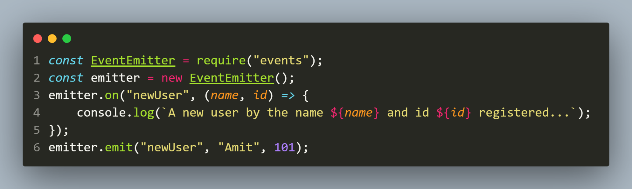
Passing multiple arguments
We can also pass multiple arguments to the event and receive them in the same order

Slide 23
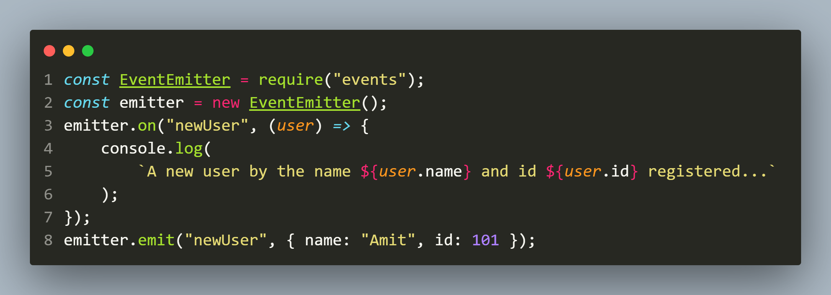
Passing object
We can also pass object as arguments to the event

Slide 24
Exercise 30
WAS to generate an event to display the number of seconds passed since the application started after every second .
The event should emit automatically

Slide 25
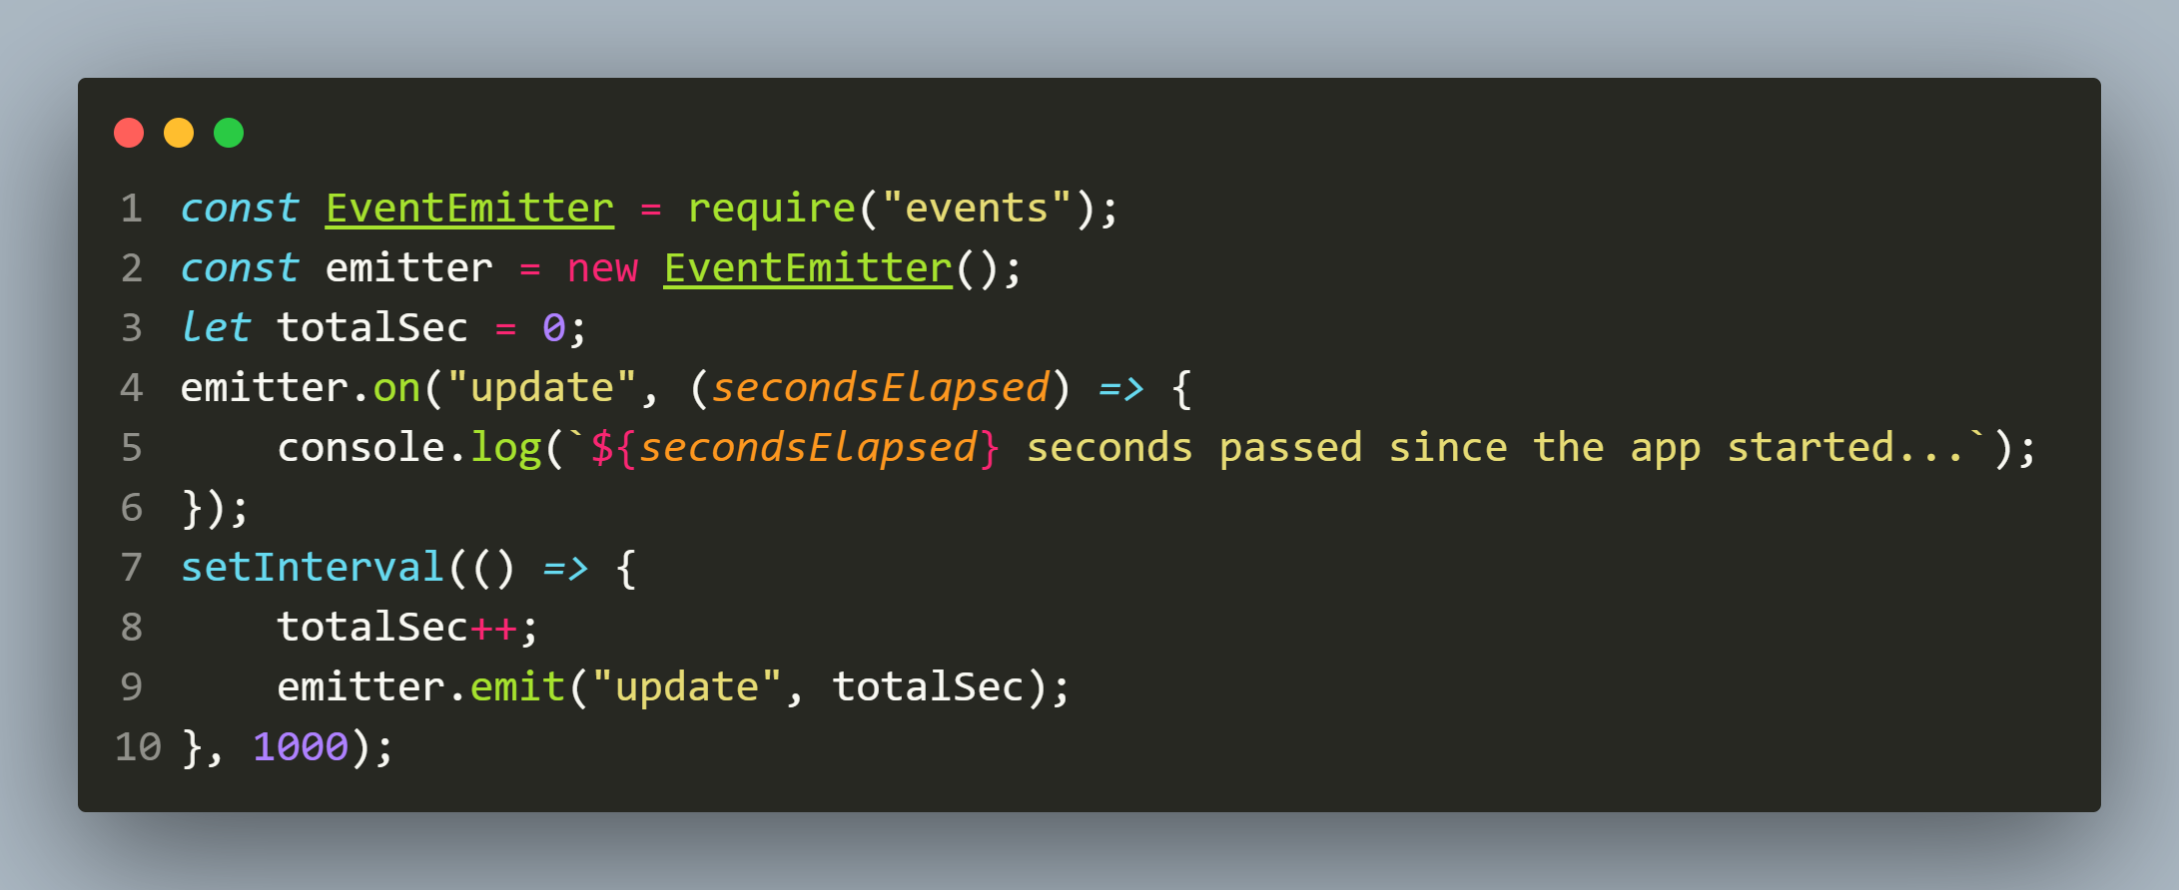
Solution

Slide 26
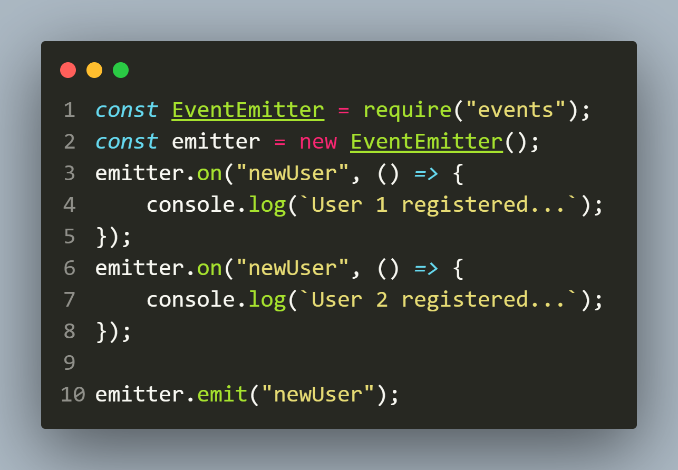
Registering multiple listeners
We can also register multiple listeners to the same EventEmitter object and they will be called in the same order in which we defined them

Slide 27
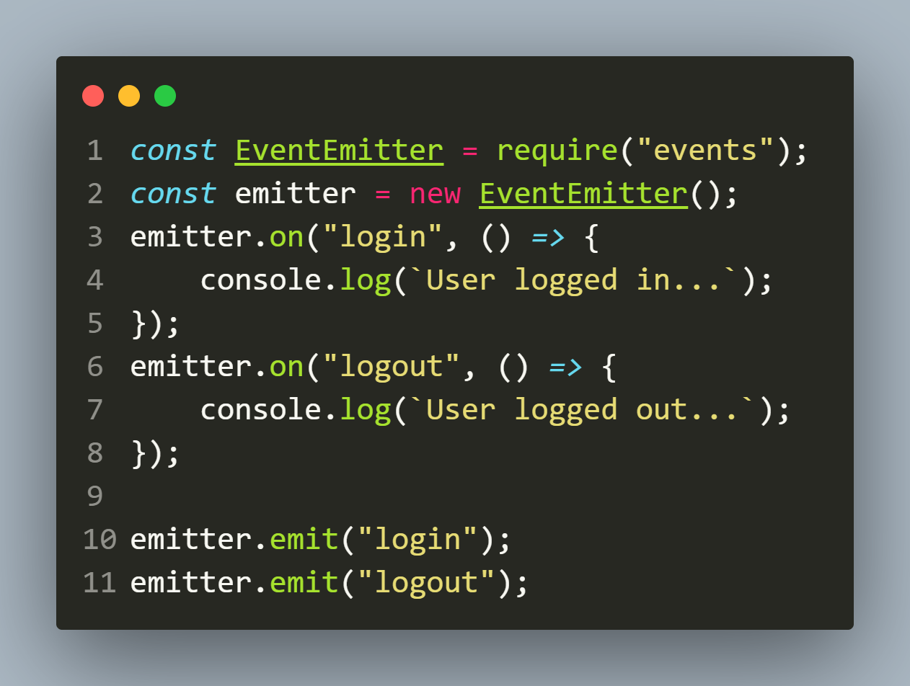
Registering multiple events
We can also register multiple events to the same EventEmitter object each having its own listener and they will be called in the order in which we emit them

Slide 28
Exercise 31
WAF to create a countdown timer which emits three events:
update: It should emit on every sec and display the number of seconds passed
end: It should emit when the countdown has finished
end-soon: It should emit , just 2 seconds before the countdown is to finish
The number of seconds the countdown timer will run will be passed as argument

Slide 29
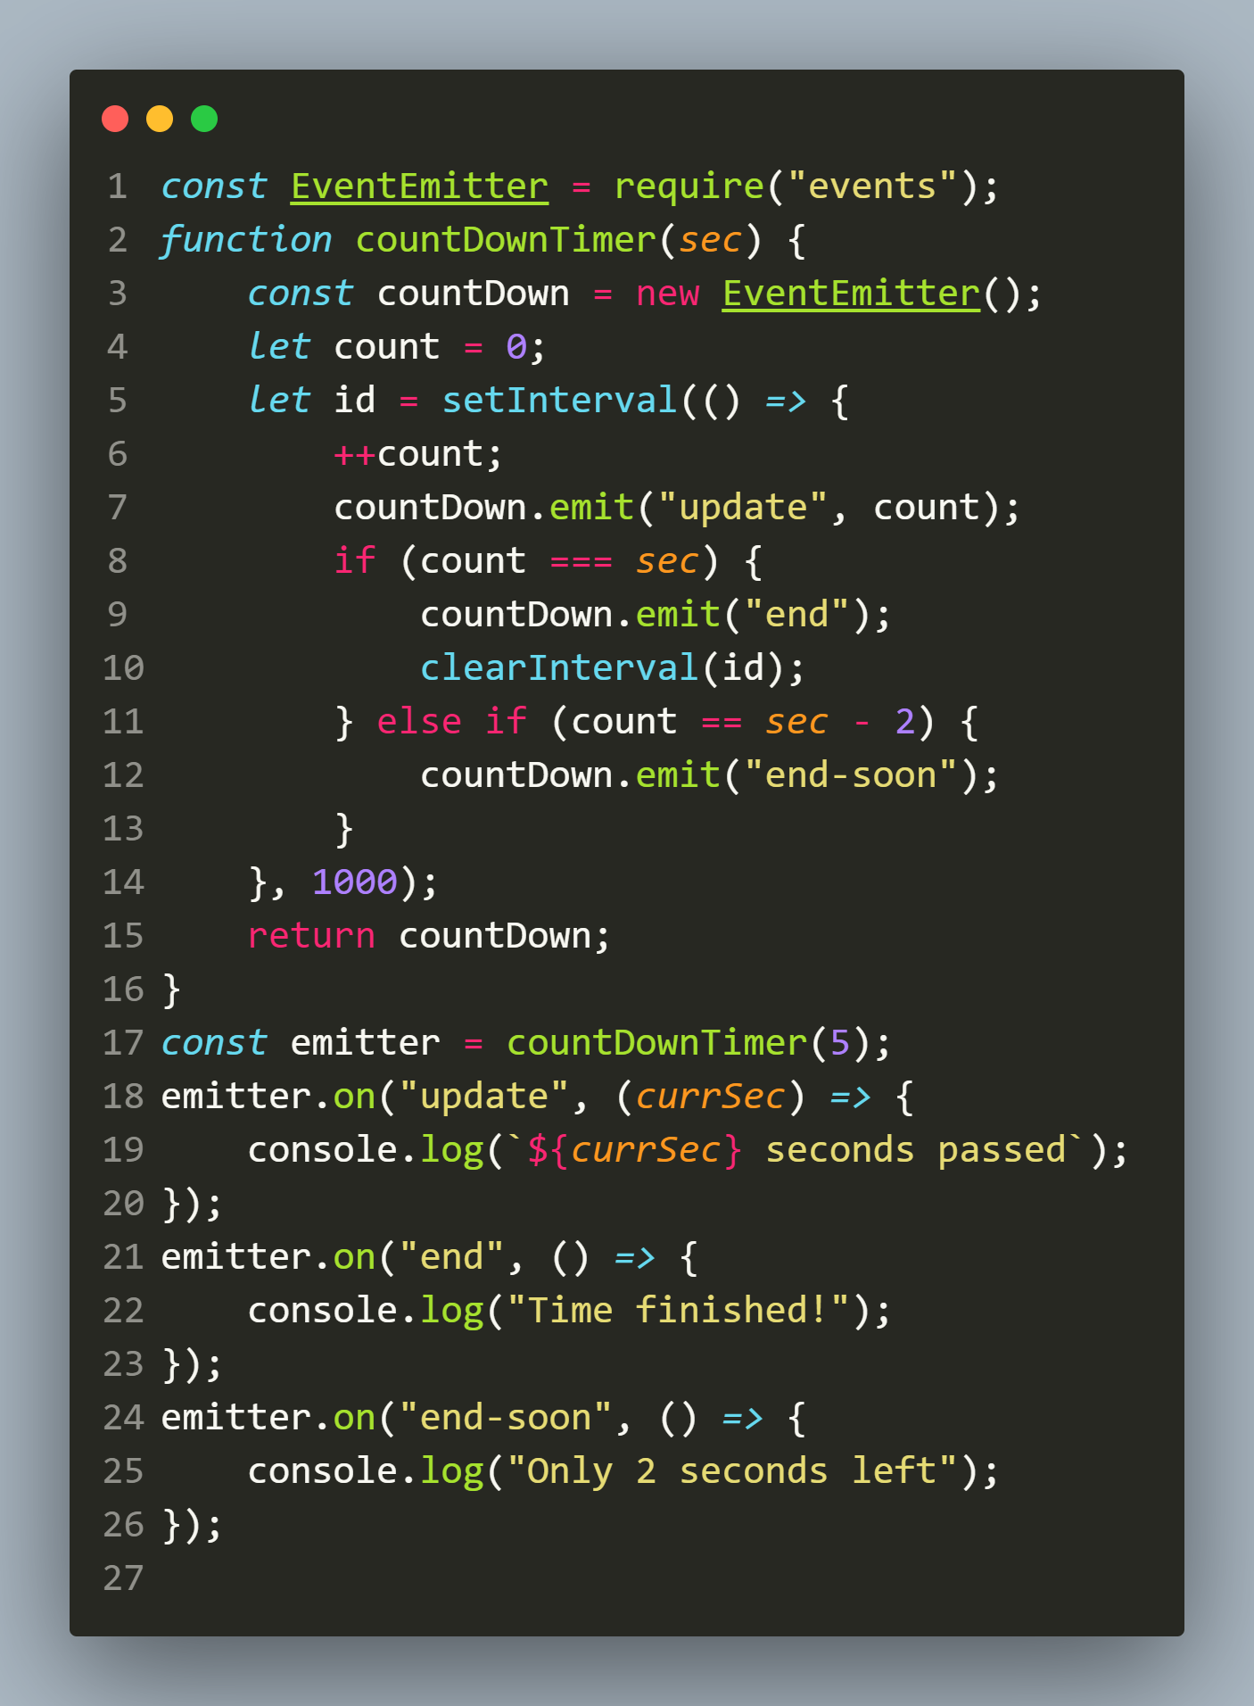
Solution

Slide 30
Creating custom eventemitter
Node strongly recommends to create our own EventEmitters by extending the EventEmitter class
Such EventEmitters are called as custom event emitters
This allows our custom event to inherit all the functionality of the EventEmitter class, such as the on() and emit() methods.

Slide 31
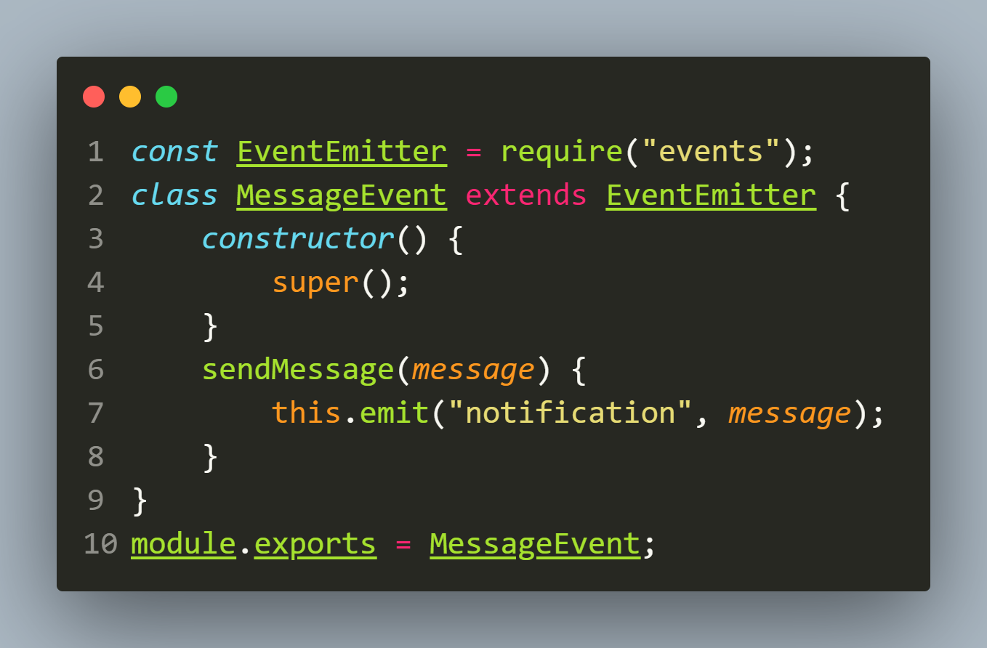
example
A custom MessageEvent class:

Slide 32
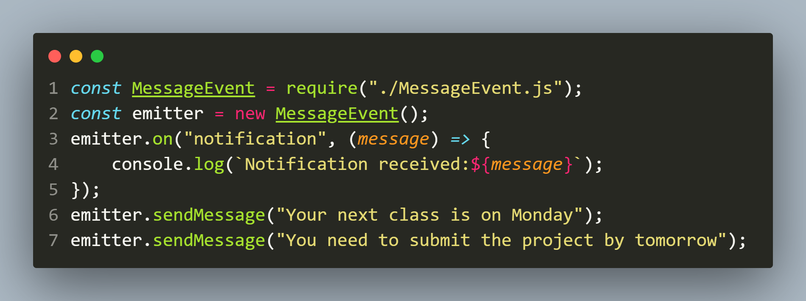
example
app.js:

Slide 33
Exercise 32
WAC called Item which should extend the EventEmitter class and provide 2 members called itemName and itemPrice.
Provide following methods in your class:
A parametrized constructor to initialize the members itemName and itemPrice
Two getter properties for itemName and itemPrice

Slide 34
Exercise 32
A setter property for itemPrice , which accepts a new price as argument and if the new price is more than the current price , then it should assign it to the current price and raise an event called priceChanged which should display itemName, old price , new price and percentage by which price increased

Slide 35
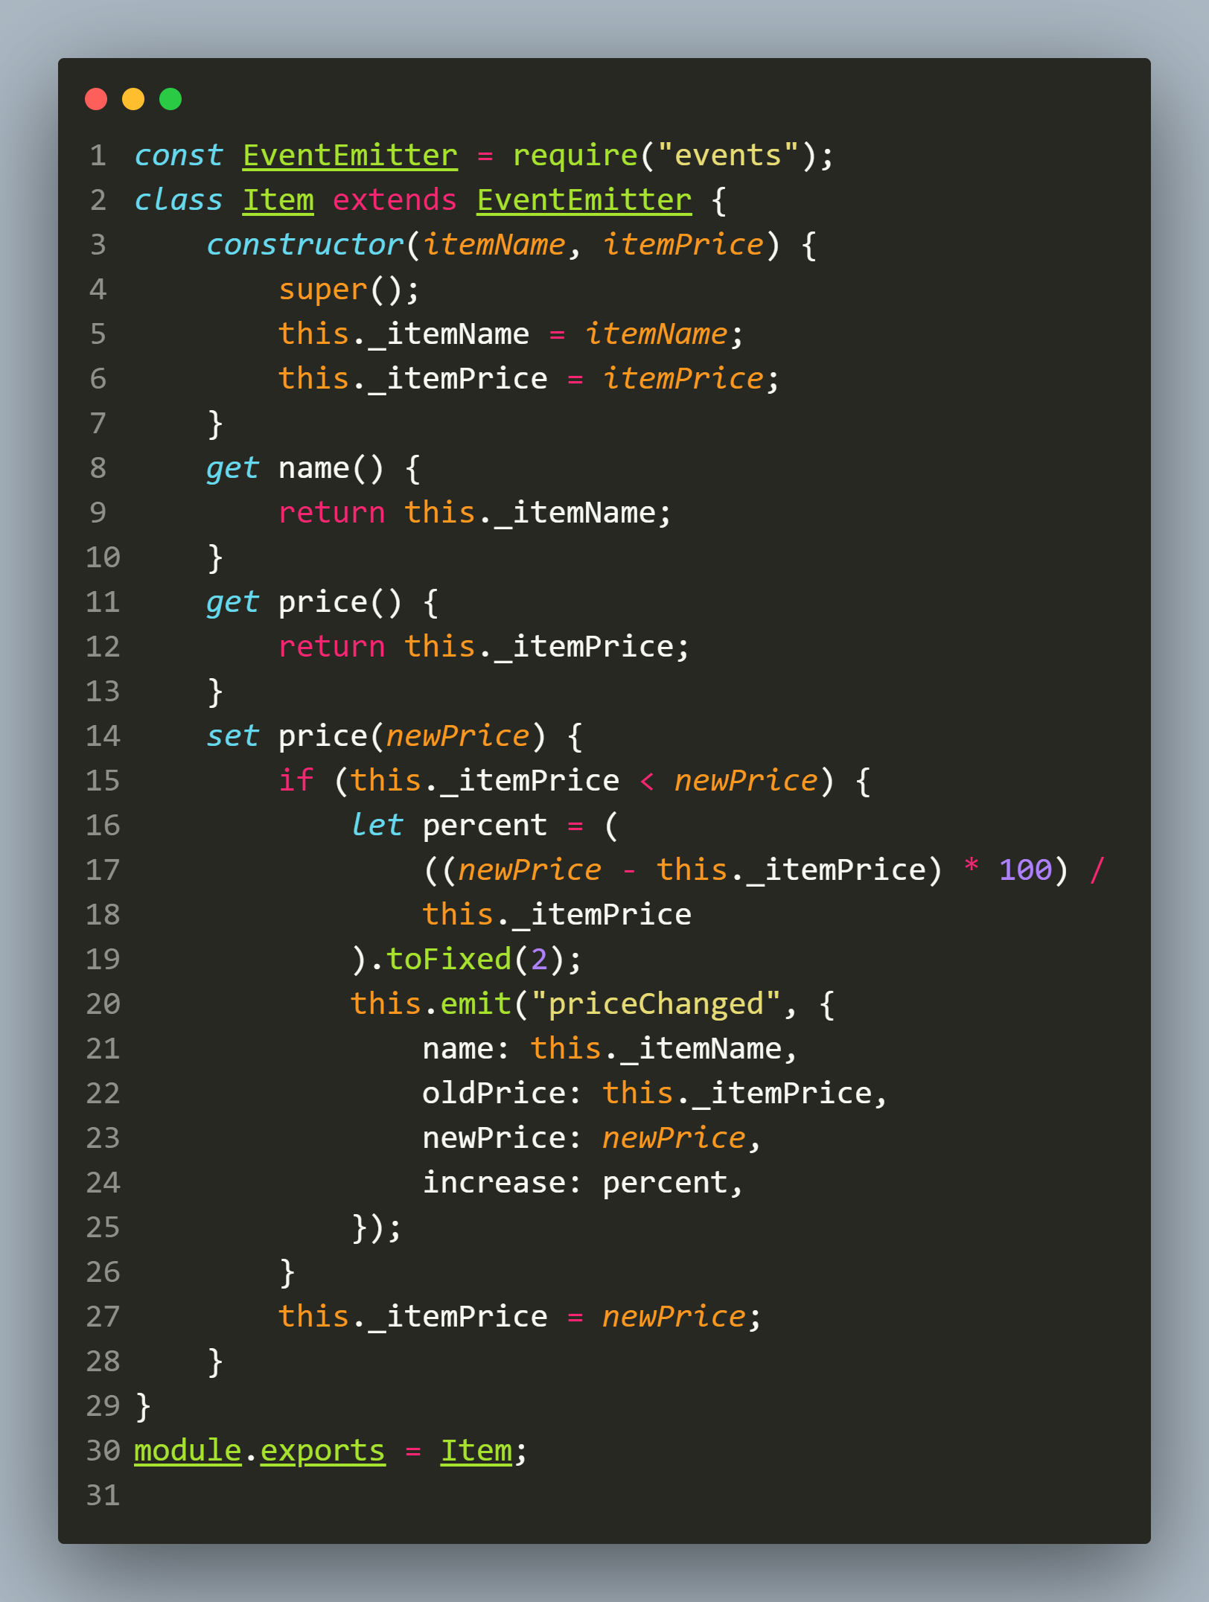
Solution

Slide 36
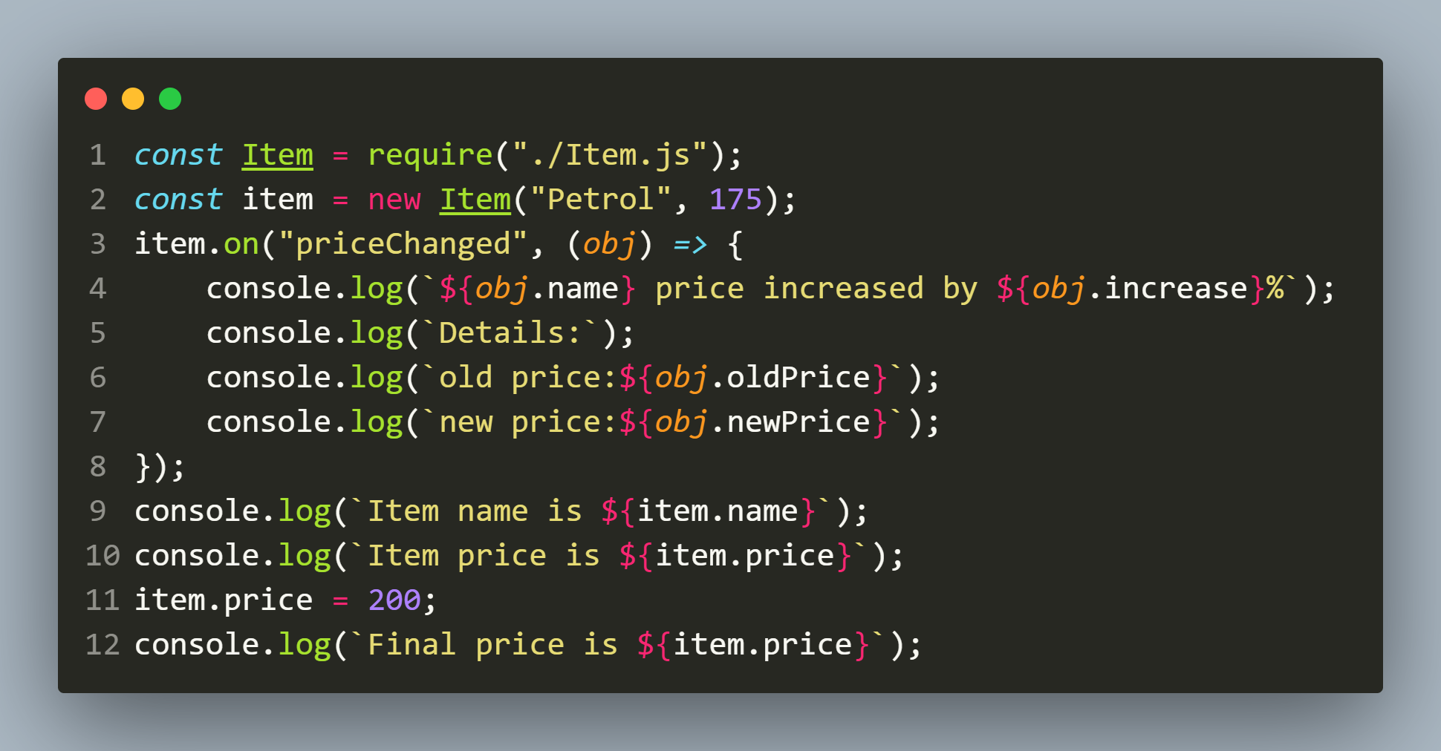
Solution

Slide 37
Removing an eventlistener
Once we create an event listener, we can also remove it using the removeListener() method or off() method of EventEmitter object.
To do so, we must have a reference to the callback function passed to the on() method.

Slide 38
Removing an eventlistener
Then we can call the removeListener() or off() method passing 2 arguments:
The event name
The callback reference

Slide 39
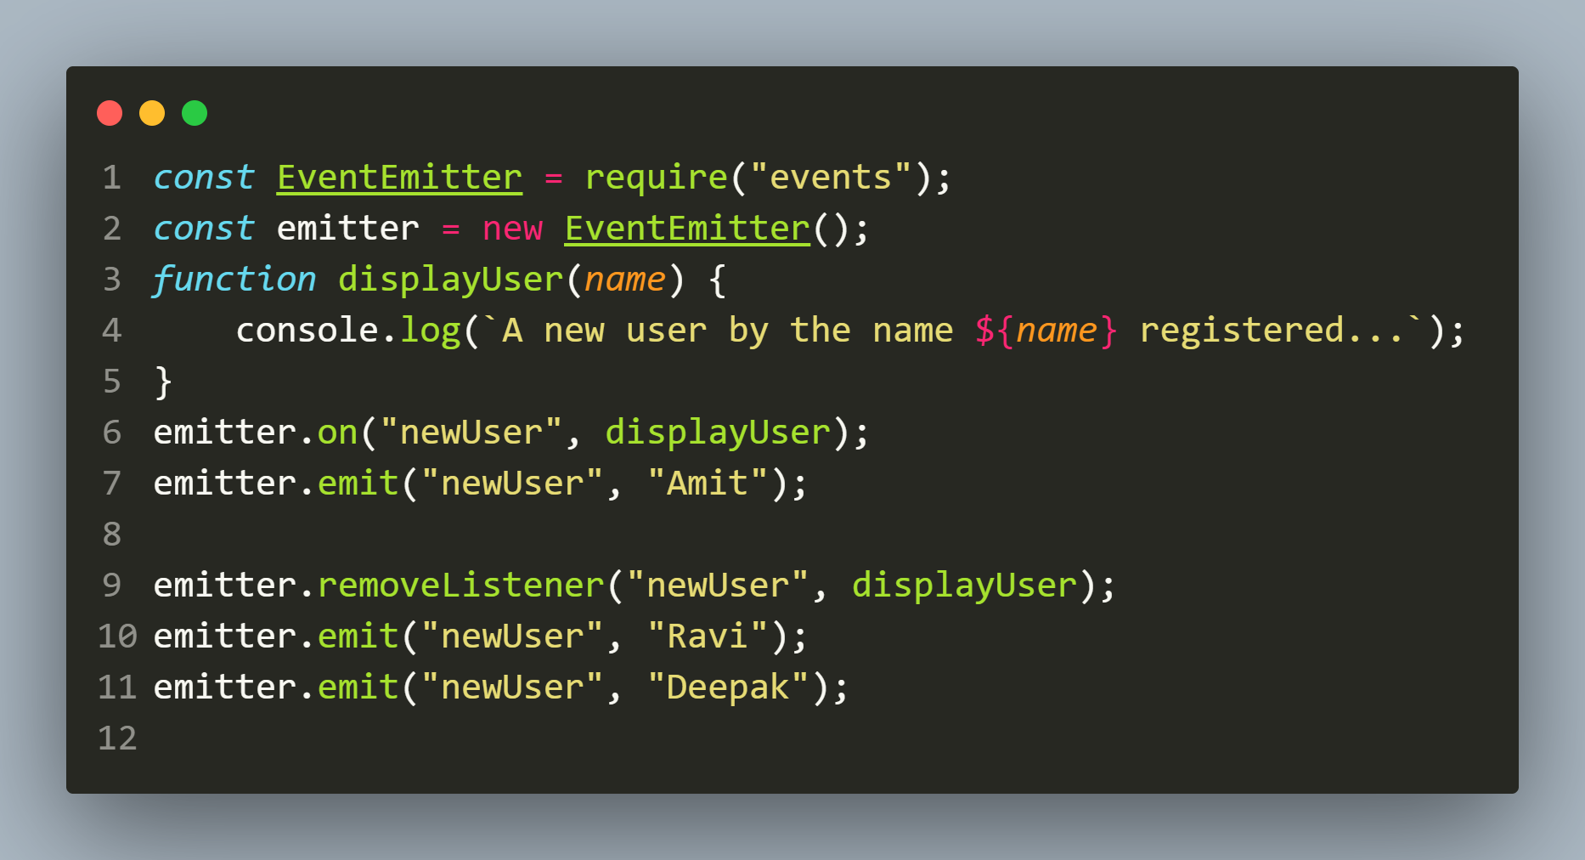
example
The code
The output

Slide 40
Removing all Listeners
If we want to remove all event listeners for a given event, we can use the removeAllListeners() method.
It takes a string argument for the event identifier.

Slide 41
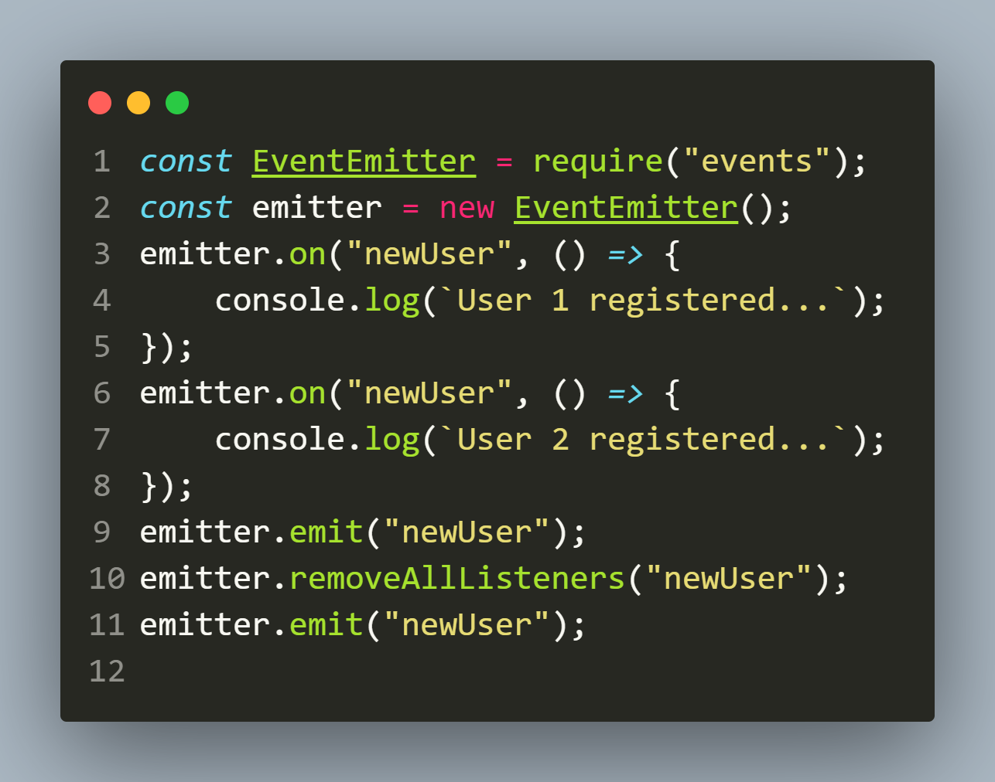
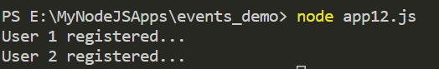
example
The code
The output

Slide 42
Listening for event just once
The EventEmitter object also provides a method by the name once(), which we can use to create a one-time event listener.
Once that event is fired, the listener stops listening.

Slide 43
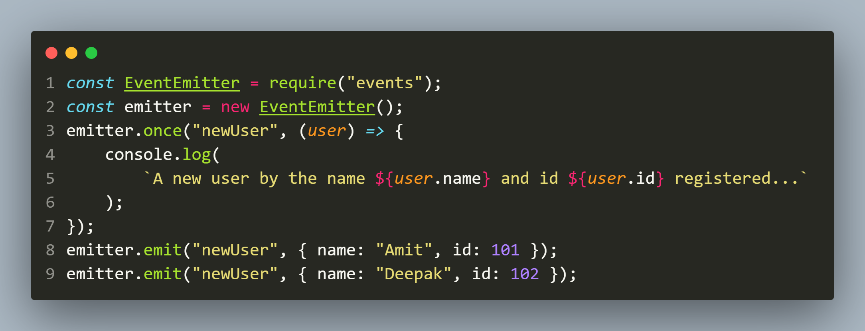
example
The code
The output

